Slide 1
컴퓨터 네트워크 Computer Networks and Internets, 6e

Slide 2
Assignment
1. Will an ICMP error message is generated if error is found in
a) a datagram having a multicast address ?
b) a datagram carrying an ICMP error message ?
c) a fragmented datagram that is not the first datagram ?
2. Compare NAT and DHCP. Both can solve the problem of a shortage of addresses in an organization, but by using different strategies.
3. Capture various packets using Wireshark, and explain fields in ICMP header.
Run wireshark and execute ping command.
© Pearson Education Inc., Upper Saddle River, NJ. All rights reserved.
2
Notes:
2

Slide 3
ICMP Message

Slide 4
ICMP Message

Slide 5
UDP: Datagram Transport Service

Slide 6
End-To-End Principle
Fundamental concept in the Internet
Network provides best-effort packet transport
Endpoints
Control communication
Provide all reliability
Consequence
Some of the most complex protocols in the Internet protocol suite run in hosts rather than in routers.

Slide 7
Transport Layer
Layer between applications and IP (layer 4)
Allows multiple applications on a given host to communicate with applications on other hosts
Uses IP to carry messages

Slide 8
Problems A Transport Protocol Can Handle
Accommodate speed mismatch between sender and receiver
Detect and recover from datagram loss
Eliminate duplicate packets
Guarantee that messages arrive in order
Respond to congestion in the Internet
Prevent delayed packets from being misinterpreted
Verify that data was not corrupted during transit
Ensure that each party has agreed to communicate
Note: a given transport protocol may not handle all problems

Slide 9
Techniques Transport Protocols Use
Application demultiplexing
Receiver determine which application should receive the packet
Flow-control mechanisms
Receiver informs sender of acceptable data rate
Sender limits rate to prevent overrunning the receiver
Congestion control mechanisms
Receiver or network informs sender about congestion in the network
Sender reduces data rate (packet rate) until congestion subsides
Sequence numbers
Sender places a sequence number in each packet
Positive acknowledgement with retransmission
Receiver sends acknowledgement , Sender retransmits packet
Sliding window

Slide 10
Transport Protocols Used In The Internet
Two primary transport protocols used in the Internet
User Datagram Protocol (UDP)
Transmission Control Protocol (TCP)
Choice determined by application protocol
Many applications specify the use of a single transport
(e.g., email transfer uses TCP)
Some applications allow the use of either (e.g., DNS queries can be sent via UDP or TCP)

Slide 11
The User Datagram Protocol
Used
During startup
For VoIP and some video applications
Accounts for less than 10% of Internet traffic
Blocked by some ISPs
UDP can be characterized as:
End-to-end
UDP can distinguish among multiple applications running on a given computer
Connectionless
Message-oriented
UDP sends and receives individual messages

Slide 12
The User Datagram Protocol
Best-effort Delivery
It offers applications the same best-effort delivery semantics as IP
Arbitrary Interaction
UDP allows an application
to send to many other applications
receive from many other applications
or communicate with exactly one other application
Operating System Independent
UDP provides a means of identifying application programs
It does not depend on identifiers used by the local OS
No congestion or flow control
© Pearson Education Inc., Upper Saddle River, NJ. All rights reserved.
12
Notes:
12

Slide 13
End-To-End Communication
UDP provides communication among applications
Sending UDP
Accepts outgoing message from application
Places message in a User Datagram
Encapsulates User Datagram in an IP datagram and sends
Receiving UDP
Accepts incoming User Datagram from IP
Extracts message and delivers to receiving application
Note: message is unchanged by the network

Slide 14
The Connectionless Paradigm
An application using UDP can
– Send a message to any receiver (universal)
Send at any time (asynchronous)
Stop sending at any time (unterminated)
That is, a sender does not
Inform the network before sending (i.e., does not establish a communication channel)
Inform the other endpoint before sending
Inform the network or other endpoint that no more messages will be sent

Slide 15
Message-Oriented Interface
UDP offers applications a message-oriented interface
Each time an application requests that UDP send data
UDP places the data in a single message for transmission
UDP does not divide a message into multiple packets
UDP does not combine messages for delivery
Message-oriented interface has several consequences:
On the positive side
applications preserve data boundaries
each message will be exactly the same as was transmitted
On the negative side
each UDP message must fit into a single IP datagram

Slide 16
UDP Message Size
UDP allows up to 64K octet messages
As a practical limit, the size of a User Datagram is limited by payload area in IP datagram
Maximum IP payload is 64K octets minus size of IP header
Therefore, the maximum UDP payload is 64K octets minus size of IP and UDP headers (usually 64K octets minus 28)
Application can choose any message size up to the maximum UDP payload
Optimal UDP message size is S=M–H (no fragmentation)
M is the path MTU (i.e., minimum MTU on the path)
H is th–e size of IP and UDP headers
© Pearson Education Inc., Upper Saddle River, NJ. All rights reserved.
16
Notes:
16

Slide 17
UDP Communication Semantics
UDP uses IP for all delivery
UDP provides best-effort delivery semantics as IP
This means messages can be:
Lost
Duplicated
Delayed
Delivered out-of-order
Corrupted
UDP's best-effort delivery semantics have important consequences for applications
An application must either be immune to the problems or the programmer must take additional steps to detect and correct problems

Slide 18
UDP Communication Semantics
As an example of an application that can tolerate packet errors, consider an audio transmission
If the sender places a small amount of audio in each message
At the opposite extreme, consider an on-line shopping application
Such applications do not use UDP
because packet errors can have serious consequences
(e.g., duplication of a message that carries a catalog order can result in
two orders, with double charges being made to the buyer's credit card)
© Pearson Education Inc., Upper Saddle River, NJ. All rights reserved.
18
Notes:
18

Slide 19
Modes of Interaction and Broadcast Delivery
UDP allows four styles of interaction:
1-to-1
1-to-many
Many-to-1
Many-to-many
An application using UDP has a choice
A 1-to-many interaction can be achieved as follows
An application to repeatedly send a message to multiple recipients, UDP allows an application to transmit the message via IP multicast or broadcast
For example, local broadcast can be specified by using IP's limited broadcast address, 255.255.255.255

Slide 20
Endpoint Identification with Protocol Port Numbers
How should UDP identify an application as an endpoint?
UDP could use the same mechanism that the OS uses
Because UDP must span heterogeneous computers
no common mechanism exists
For example
some OS use process identifiers
others use job names
and others use task names
To avoid ambiguity
UDP defines an abstract set of identifiers called protocol port numbers that are independent of the OS
UDP must provide a mapping between protocol port numbers and the program identifiers that the OS uses
All computers running UDP recognize the standard protocol port numbers, independent of the OS

Slide 21
Identifying An Application
Both sending and receiving applications need a port number
Assignment of port numbers depends on the type of application (IANA)
Application that offers a standardized service (server)
Uses a well-known port number for the service
Value is less than 1024
TCP: 21 FTP, 22 SSH, 23 Telnet, 25 SMTP, 80 HTTP, 110 POP3
UDP: 53 DNS, 67 DHCP, 69 TFTP, 161 SNMP
Registered number (1024 – 49151)
Other applications (client)
Request a port number from the local operating system
Value is greater than 49151

Slide 22
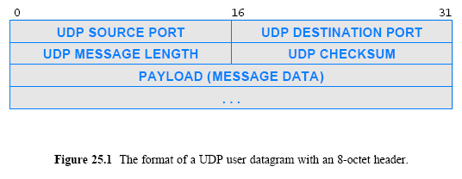
UDP Datagram Format
Each UDP message is called a user datagram and consists of two parts:
a short header that specifies the sending and receiving application
a payload that carries the data being sent
Figure 25.1 (below) illustrates the user datagram format.

Slide 23
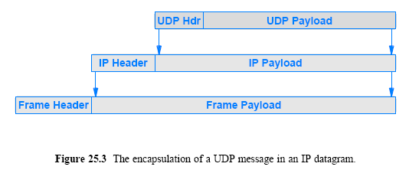
UDP Encapsulation
Each UDP datagram is encapsulated in an IP datagram for transmission across the Internet
Figure 25.3 (below) illustrates the encapsulation

Slide 24
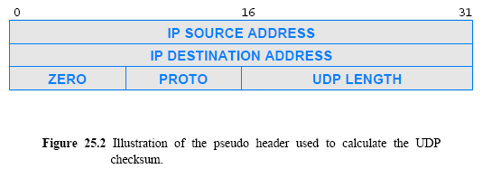
The UDP Checksum and the Pseudo Header

Slide 25
The UDP Packet

Slide 26
The UDP Packet

Slide 27
The UDP Checksum and the Pseudo Header
UDP header contains a 16-bit field named UDP checksum (optional)
A sender can either choose to compute a checksum or set all bits of the checksum field to zero
When a message arrives at the destination
UDP software examines the checksum field
and only verifies the checksum if the value is nonzero
UDP uses a ones-complement checksum
To verify that messages to reach the correct destination without incurring the overhead of additional header fields
UDP extends the checksum
Includes extra pseudo header that contains IP addresses

Slide 28
Assignment
Explain how we can get reliable transfer through unreliable protocol UDP.
2. The following is a dump of a UDP header; 0045DF0000580000
1) Is the packet directed from a client to a server or vice versa?
2) What is the length of the data?
3) How the sender handled checksum for this packet?
3. Capture various Ethernet frames using Wireshark, and explain fields in the Ethernet, IP, and UDP header.
Send your solution to me by email. (Due date: Sat. /24PM)
This assignment will be used to check your attendance.
© Pearson Education Inc., Upper Saddle River, NJ. All rights reserved.
28
Notes:
28

